Slide 1
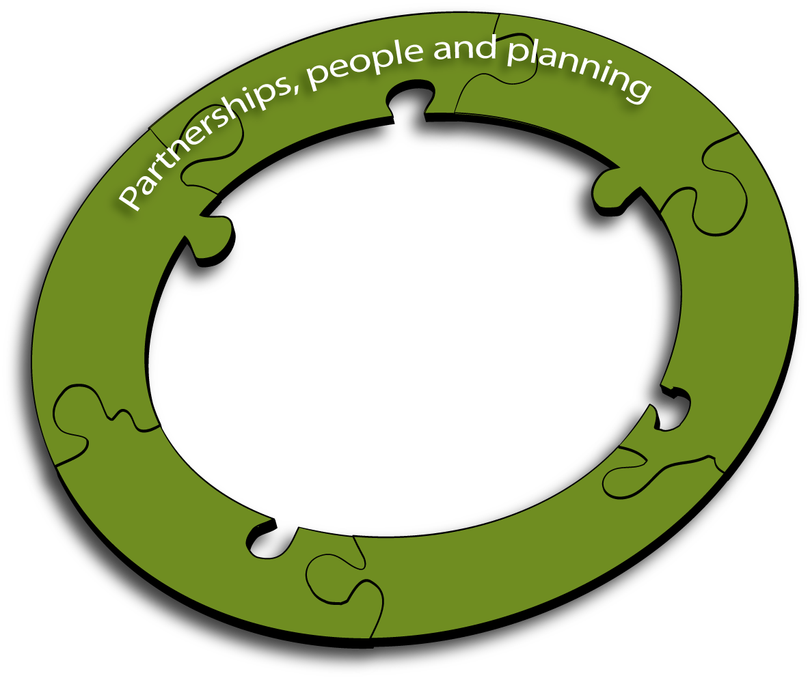
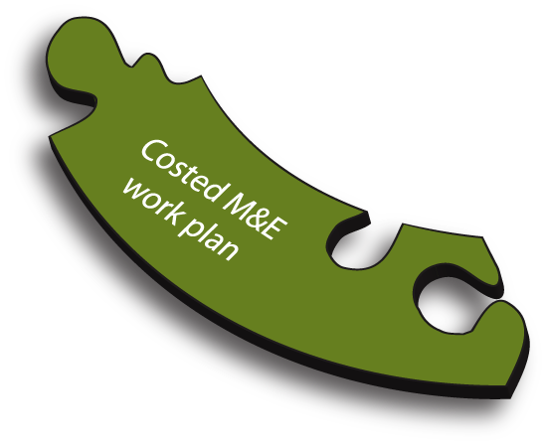
12 Components of an M&E System

Slide 2
Introduction to Operations Research
Dr. Sumit Malhotra, MD
Assistant Professor, Indian Institute of Public Health,
Public Health Foundation of India, New Delhi

Slide 3
Objectives of the session
To understand the relevance of operations research in HIV/AIDS programs
To know what OR is? What is OR cycle?
To be familiar with designs commonly used in OR.

Slide 4
HIV Prevention and Circumcision
1980s- Low prevalence of male circumcision in the parts of sub-Saharan Africa most affected by the epidemic
A review of 28 observational studies in African countries concluded that circumcised men had about a 44 percent lower risk of HIV infection compared to circumcised men.
Conflicting results- DHS
Weak associations
Religion or culture
Need for Experimental studies

Slide 5
3 Trials Performed
In South Africa, Orange Farm, 3,000 men aged 18 to 24; circumcised men 60 % less likely to acquire HIV than the uncircumcised men
In Uganda’s Rakai District, 4,996 men aged 15 to 49, circumcision reduced the risk by 51 %
In Kenya, Kisumu, 2,784 men aged 18 to 24 ; risk was reduced by 59 %.
An ongoing follow-up study found that this protective effect was sustained over 42 months, reducing men’s chances of becoming infected with HIV by 64 %

Slide 6
Circumcision Introduction Framework

Slide 7
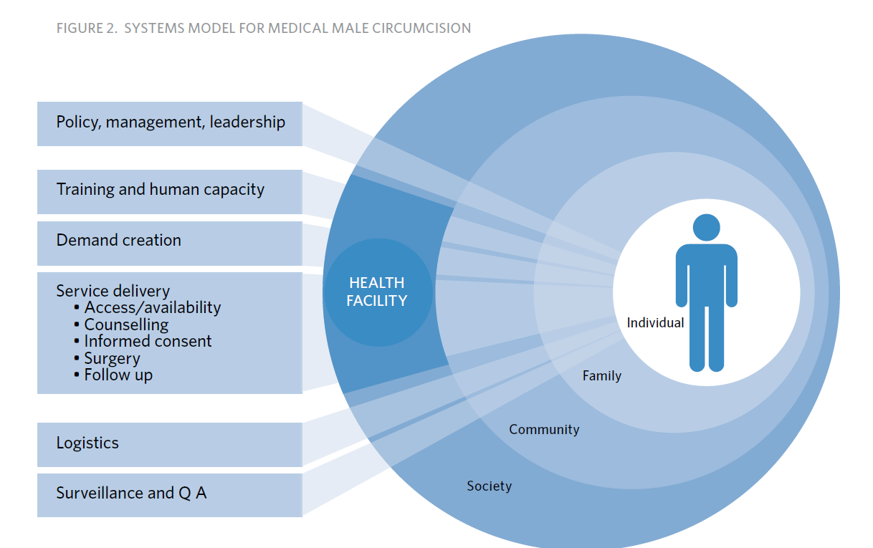

Slide 8
Operations Research
SCIENCE OF BETTER
Improvements

Slide 9
Definitions of OR
Any research producing practically-usable knowledge (evidence, findings, information, etc) which can improve program implementation (e.g., effectiveness, efficiency, quality, access, scale-up, sustainability) regardless of the type of research (design, methodology, approach) falls within the boundaries of operations research
- GF, USAID,WHO,TDR,UNAIDS & WB

Slide 10
Definitions of OR
OR has its roots in military and industrial modeling
discipline of applying advanced analytical methods, including mathematical models, to help make better decisions
Notes:
Scheduling of airline crews
Queuing systems at disney theme parks

Slide 11
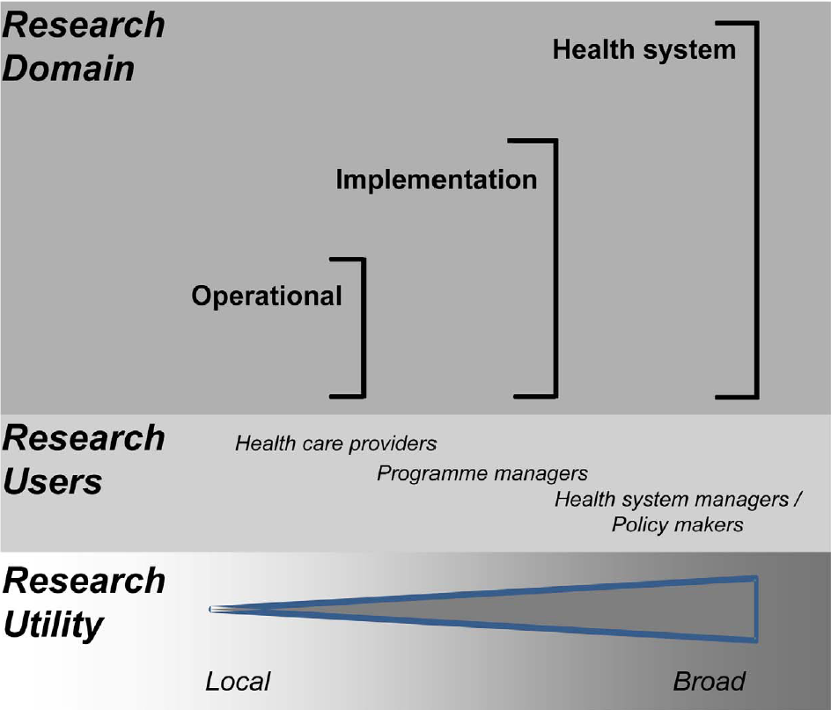

Slide 12
Scope of OR
Identify common implementation problems and their main determinants which prevent effective access to interventions and determine which of these problems are susceptible to research
Develop practical solutions to these problems and test whether new implementation strategies based on these solutions can significantly improve access under conditions of routine disease control

Slide 13
Scope of OR
Determine - in collaboration with partners – the best way to introduce these new implementation strategies into the health system and facilitate their full scale implementation, evaluation and modification, as required

Slide 14
Example- Identifying the problem
Despite patients offered ARVs, OIs like diarrhea and pneumonia were high amongst them.
Why are HIV positive clients experiencing poorer health outcomes?
Problem of adherence to regimens.

Slide 15
Example- Considering the reasons
Poor communication between clients and staff
Low income clients do not have enough money for transportation – refill their prescriptions
Clients can not afford to miss their work to come to clinic
Perceived stigma
Frequent drug stock outs

Slide 16
Example- Testing the solutions
Drug stock outs-
Staff in service training to improve drug forecasting
Developing clinic based performance standards that inform the basis for problem solving among staff
Which solution solves problem best?

Slide 17
Characteristics of OR- 1
It addresses specific problems within specific programs, not general health issues;
It addresses those problems that are under control of managers, such as program systems, training, pricing and provision of information;

Slide 18
Characteristics of OR- 2
It requires collaboration between managers and researchers in identification of the research problem, development of the study design, implementation of the study and analysis and interpretation of results; and
It succeeds only if the study results are used to make program decisions; publication alone is not a valid indicator of successful OR.”

Slide 19
OR Access Problem - Example
Program Problem: How to get more adolescents to use reproductive health clinic
Managerial Factors: Price, hours, provider training…
Output: More visits to clinic by adolescents
Outcome: More contraceptive use
Impact: Fewer unwanted pregnancies

Slide 20
OR is Not Methodologically Defined
Different methods used in OR studies:
• Quantitative
• Qualitative
• Surveys
• Experiments

Slide 21
Does OR in public health requires complex modeling techniques?

Slide 22
Examples
Improving effectiveness of medical interventions
Assessing feasibility in definite population or setting
Advocating for policy change

Slide 23
Example – Improving effectiveness of medical interventions
Author | Study description | Main Findings | Policy implications
Zachariah et al | Payment for ARV drugs is associated with higher rate of patients lost to follow up than those offered free of charge therapy in Nairobi, Kenya | 58% higher risk of loss to follow up associated with payment for ART; ART dose dilutions by patients who had to pay for ART | Detrimental effect of payment based therapy on outcomes, service began free of charge in hospitals

Slide 24
Example – Assessing feasibility in definite population or setting
Author | Study description | Main Findings | Policy implications
Bedelu et al | Descriptive report of a rural model of antiretroviral treatment | A decentralised, simplified model of antiretroviral therapy delivery based on nurses was feasible in rural South Africa | Led to policy change in allowing non-physician clinicians to administer antiretroviral therapy

Slide 25
Example – Advocating for policy change
Author | Study description | Main Findings | Policy implications
Van Griensven et al | High prevalence of lipoatrophy among patients on Stavudine containing first line ART in Rwanda | Showed that lipoatrophy was an important complication of WHO recommended first line ART regimens | Highlighted the urgent need for access to more affordable and less toxic ART regimens in Africa

Slide 26
Examples for contemplation: Access
Low coverage
Failure to scale-up
Equity issues such as not reaching the poor, those living in remote areas, the marginalized, women, children, adolescents
Not reaching those who are stigmatized
Insufficient staffing - may need to look at task shifting approaches, e.g., use of community workers.

Slide 27
Examples for contemplation: Quality issues
Poor quality of services and target groups avoiding the service
Poor diagnostic and dispensing services
Other technical problems
Poor information/education/communication (IEC) programs
No job aids or poor use of them
Poor referral systems

Slide 28
Examples for contemplation : Managerial issues
Poor adherence to policy recommendations
Poor record-keeping and reporting, M&E
Poor information dissemination
Interaction or competition with other interventions for other diseases
Marketing and advocacy

Slide 29
Examples for contemplation: Delivery System at Community/ Individual level
Levels of household income that influence affordability
Stigma
Other participation barriers
Perceptions and misperceptions

Slide 30
OR is successful only if the results are used to make program decisions
Published papers are not valid indicators of OR success

Slide 31
Steps in the OR Process- Nut shell
Identify the problem
Generate solutions
Test intervention to solve the problem
Ensure results are used
Disseminate results
Context: Programs

Slide 32
Types of OR
Diagnostic studies: used to assess the nature and extent of a health or service delivery problem.
Evaluative studies: used to evaluate ongoing innovative health interventions.
Intervention studies: used to test, the effectiveness of service delivery interventions explicitly designed to address a specific service delivery problem
Cost-effectiveness studies: Cost of Effectiveness not known

Slide 33
Diagnostic/Formative Research
Descriptive studies
Done when reason for program problem is unknown or to determine if problem exists
Suggests possible solutions

Slide 34
CROSS SECTIONAL STUDY
With outcome
Subjects selected
for the study
Without outcome
Question: What is happening?
Onset of study
Time
No direction of inquiry

Slide 35
CASE CONTROL STUDY
Exposed
Cases
Unexposed
Exposed
Controls
Unexposed
Onset of study Time
Question: What happened?
Direction of inquiry

Slide 36
COHORT STUDY
Subjects (exposed)
With outcome
Without outcome
Cohort selected for study
With outcome
Controls (unexposed)
Without outcome
Question: What will happen?
time
Onset of study
Direction of inquiry
Fig: Schematic diagram of cohort study design. Shaded areas represent subjects exposed to the antecedent factor; unshaded areas correspond to unexposed subjects. Squares represent subjects with the outcome of interest; diamonds represent subjects without the outcome of interest

Slide 37
Intervention Research
Experiments
Factors under manager’s control
Tests solutions to program problems
Compares alternatives

Slide 38
Usual Notation in intervention studies

Slide 39
Characteristics of true experiments and quasi experiments
True Experiment | Quasi-experiment | Characteristics
Yes | Yes | Includes manipulated independent variables
Yes | Yes | Includes a comparison
Yes |  | A high degree of control over the experimental situation (most notably a random assignment)

Slide 40
What is a quasi-experiment
Studies that aim to evaluate interventions but lack randomization
Aim to demonstrate causality between an intervention and an outcome

Slide 41
Post-test only design
Notes:
Design full of problems and all threats to validity- selection, history, maturity, mortality exist

Slide 42
Pretest- Posttest design

Slide 43
Static-group comparison

Slide 44
Non-equivalent control group

Slide 45
Time Series Design
Notes:
Effect of anti-smoking campaign

Slide 46
Mass Media Campaign- condom use-1
Notes:
There is no difference in o1, o2,o3 but then a sudden increase occurs between o3 and 04 which is subsequently maintained in 05 and o6, u can conclude with some degree of confidence that the increase is due to effect of intervention
There are possible threats to validity- History or instrumentation- history: decrease in price of condoms, instrumentation- change in the methodology used to calculate sales
Though these threats exist but what is important time series help in making false decisions

Slide 47
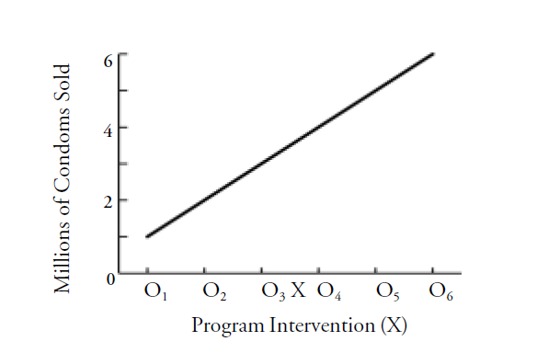
Mass Media Campaign- condom use-2
Notes:
The increase is no greater between 03 and 04, when the intervention X took place, than is at any other time
Multiple observations help u in plotting trend
If there are any 2 observations – mistakenly U will conclude that the campaign had made the difference

Slide 48
Mass Media Campaign- condom use-3
Notes:
The trend here is regular and marked by alternating increases and decreases in condom sales. The advertising campaign did not make any difference in this regard. So if suppose there are just 2 observations , it would have shown that there is effect of intervention

Slide 49
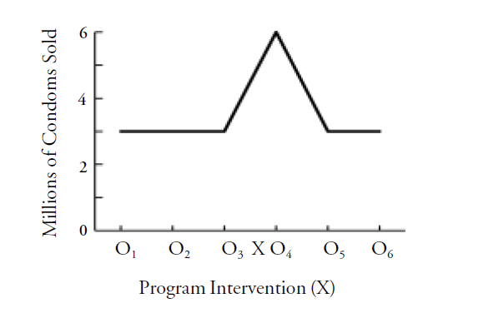
Mass Media Campaign- condom use-4

Slide 50
Time series design with non equivalent control group
Group 1
O1 O2 O3 O4 O5 X O6 O7 O8 O9 O10
Group 2
O1 O2 O3 O4 O5 O6 O7 O8 O9 O10

Slide 51
Evaluation
Usually descriptive and retrospective
Deals with factors under and not under managers’ control
Focus on attainment of project objectives
Can use experiments
Line between OR and evaluation often blurred

Slide 52
Categories OR- not mutually exclusive
Exploratory / diagnostic phase
Key variables of importance
Field Intervention
Test different problem solutions
Evaluation- impact assessment
Cost- effectiveness analysis

Slide 53
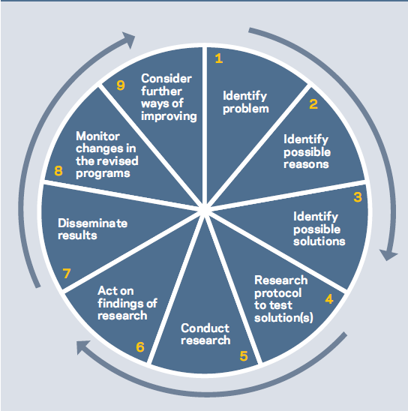
OR Steps

Slide 54
References
WHO, Global Fund (2008) Framework for operations and implementation research in health and disease control programs
WHO, The Global Fund. Guide to operational research in programs supported by global fund
Zachariah R, Harries AD, Ishikawa N, Reider HL, et al. Operational research in low-income countries: what, why, and how? Lancet2009;9:711-717
Fisher A et al. (2002). Designing HIV/AIDS Intervention Studies. An Operations Research Handbook. New York: The Population Council.

Slide 55
THANKS

